Slide 1
TRAVELER TRIP DATASET
SUBMITTED BY
AISWARYA S

Slide 2
DATA SET
travel_details.csv
Size of data – (139,13)
Names of column -
['Trip ID', 'Destination', 'Start date', 'End date', 'Duration (days)’,
'Traveler name', 'Traveler age', 'Traveler gender', 'Traveler nationality’,
'Accommodation type', 'Accommodation cost', 'Transportation type', 'Transportation cost']

Slide 3


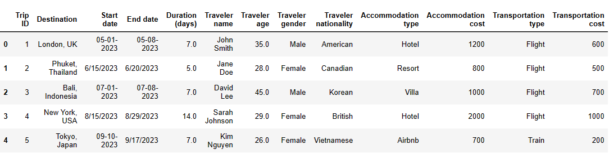
Loading necessary libraries and data
Load the dataset
Overviewing the data

Slide 4

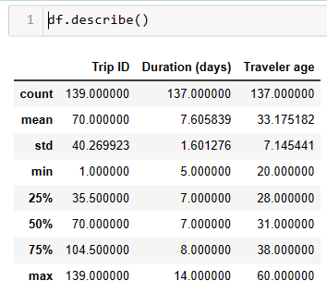
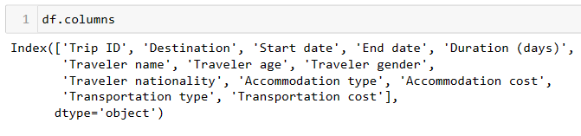
Viewing descriptive status of the data

Slide 5
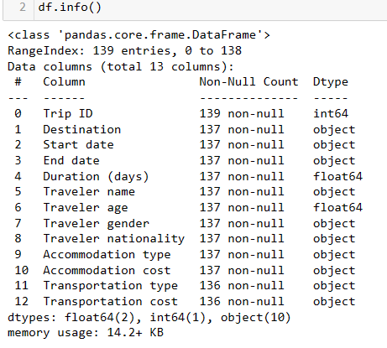
DATA CLEANING

Slide 6
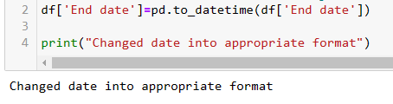
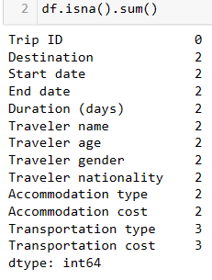
We can see that the end date is in object data type. we are gonna fix that so that we can use it in plots without any issues.
Checking null values

Slide 7
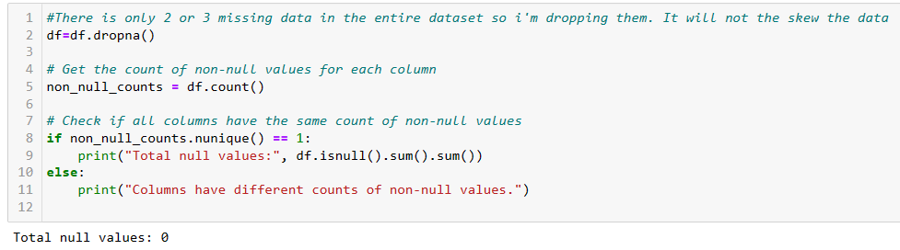
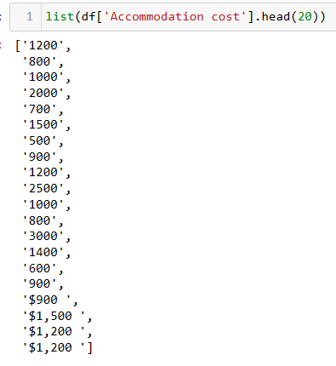

Slide 8
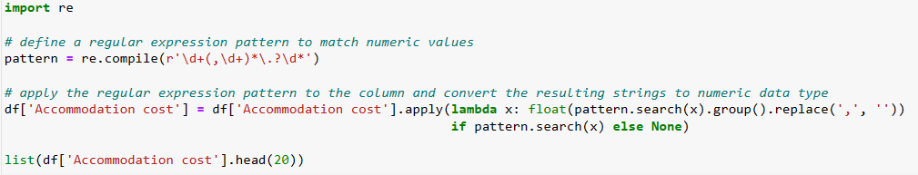
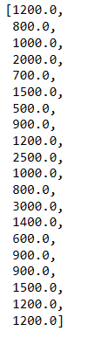

Slide 9

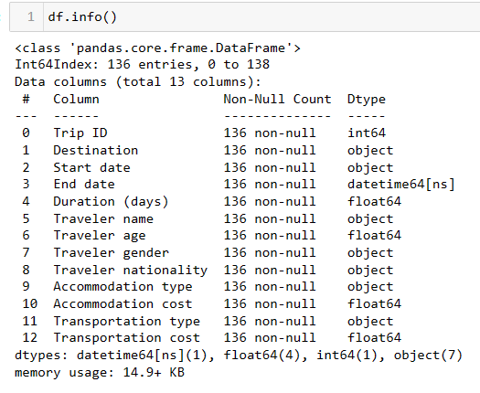
Apply the regular expression pattern to the column and convert the resulting strings to numeric data type

Slide 10
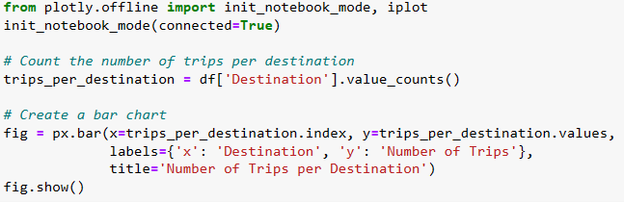
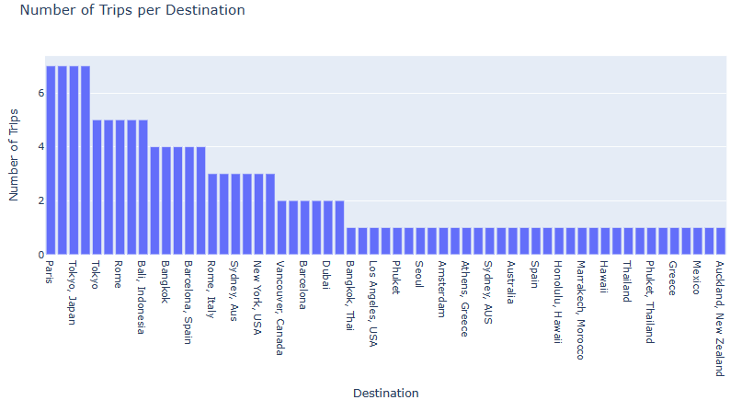
DATA VISUALIZATION

Slide 11
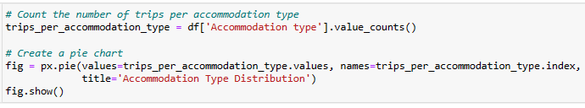
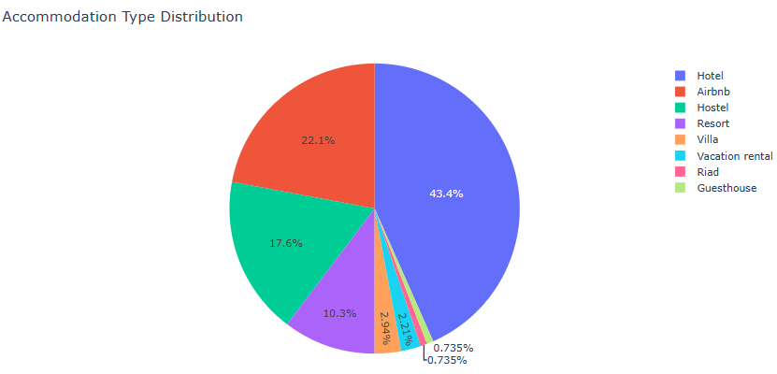

Slide 12

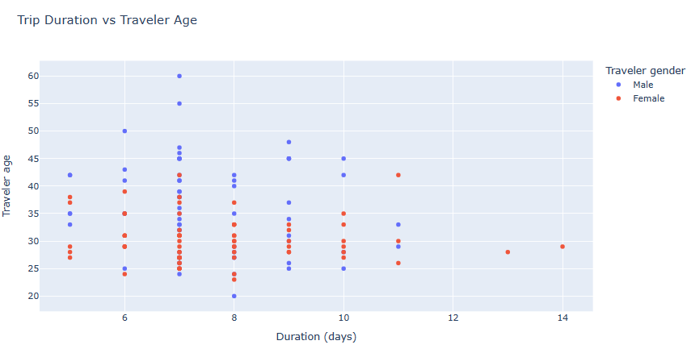

Slide 13
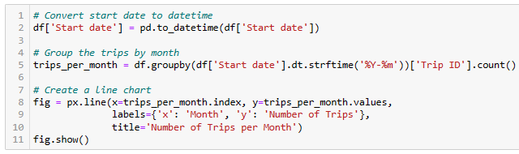
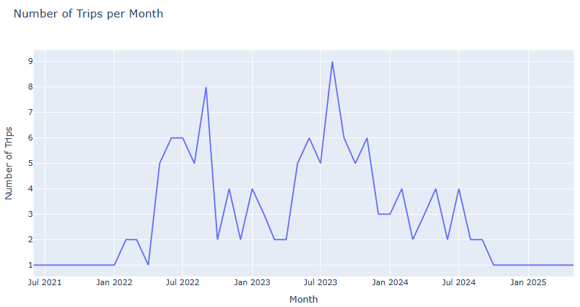

Slide 14
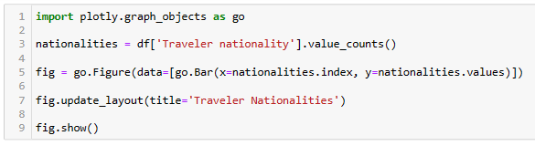
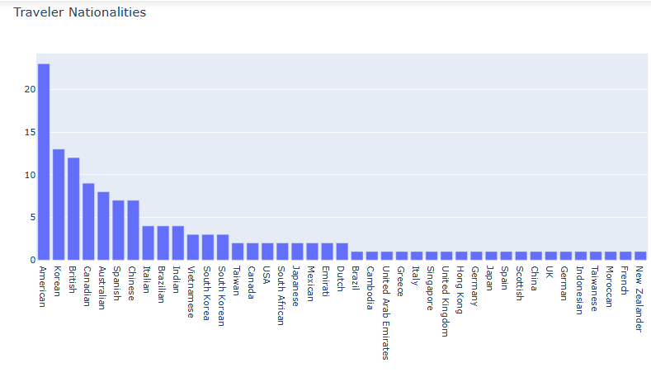

Slide 15
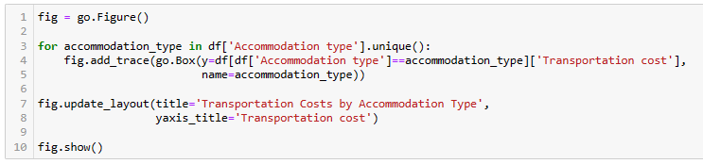
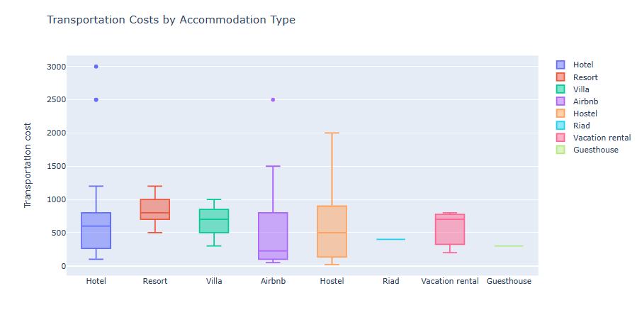

Slide 16
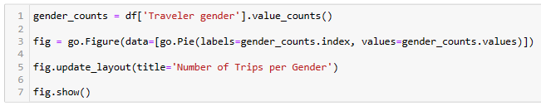
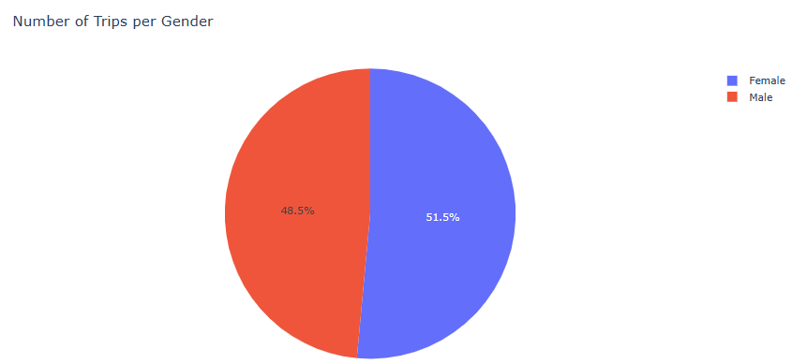

Slide 17
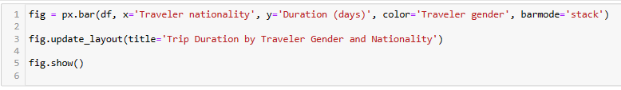
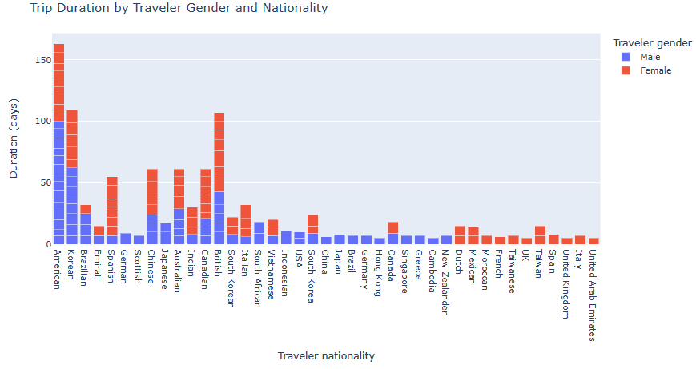

Slide 18
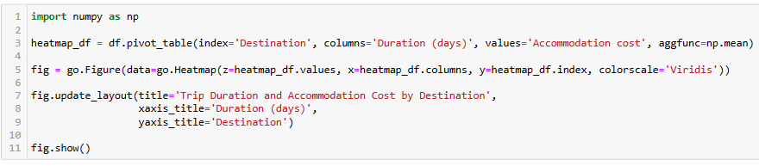
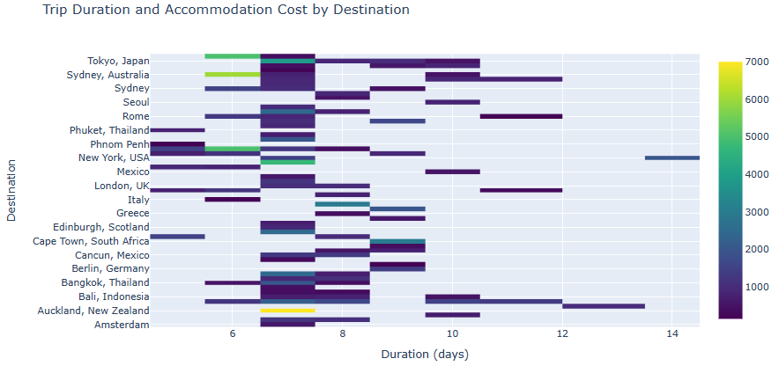

Slide 19
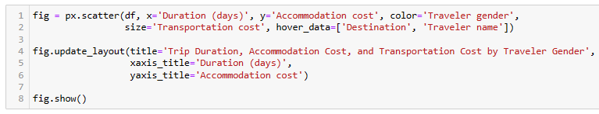
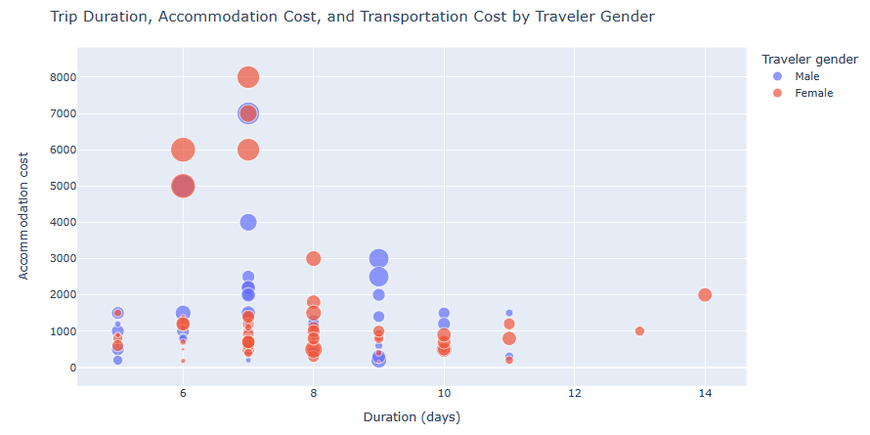

Slide 20
Conclusion from the above distribution
Most of the people are choosing their travel destination as Paris,Tokyo in Japan,Rome etc.
Most of the people are choosing hotels for accommodation purpose.
More mens are traveling above the age of 40 than the womens but womens in the age of 25 to 30 are spending more days in their trips than mens.
The analysis showing that July is the month most of the peoples are choosing for their trips.
American,Korean and British citizens are traveling more than the other country citizens.
Now a days transportation cost is high in the case of hostels for accommodation.
Females are traveling more than males.

Slide 21
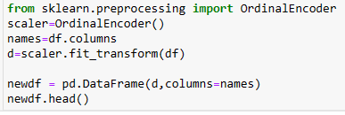
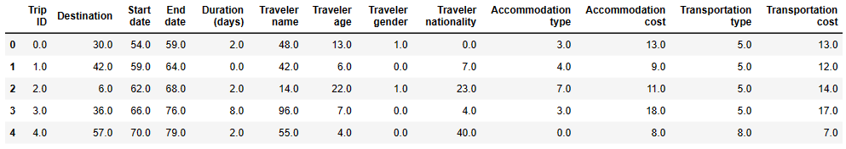
MACHINE LEARNING
Encode variables OrdinalEncoder()

Slide 22
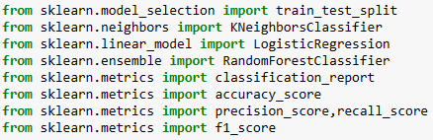
ML Models
Importing necessary libraries from their corresponding modules

Slide 23
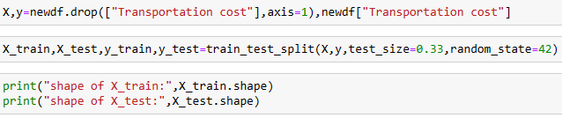

Split Data into Train and Test set

Slide 24
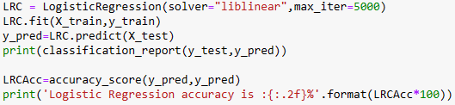
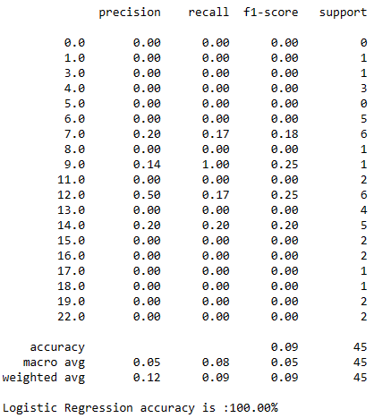
Logistic Regression

Slide 25
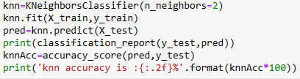
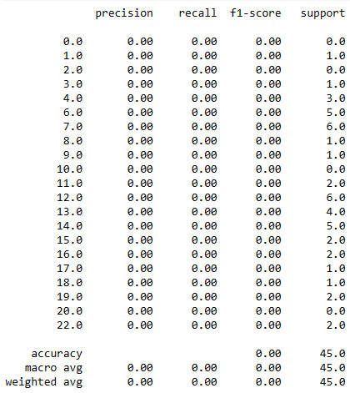
K Nrearest Neighbors Classifier

Slide 26
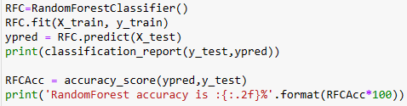
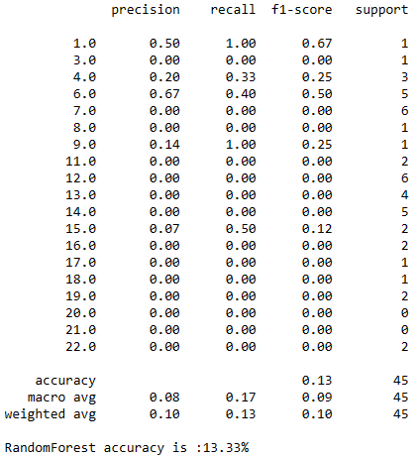
Random Forest Classifier

Slide 27
CONCLUSION
Logistic regression has an accuracy of 100.00%
K Nearest Neighbors classifier has an accuracy of 0.00%
Random forest classifier has an accuracy of 13.33%

Slide 28
REFERENCE
https://www.kaggle.com/datasets/rkiattisak/traveler-trip-data
https://www.kaggle.com/code/sridharstreaks/traveler-trip-analysis-and-automatic-eda

Slide 29
THANK YOU

